Slide 1
Integrating ESG Risks Into Credit Assessment: Sustainability Use Case PoC
Brandon Yu Seung Gyun
April 2025

Slide 2
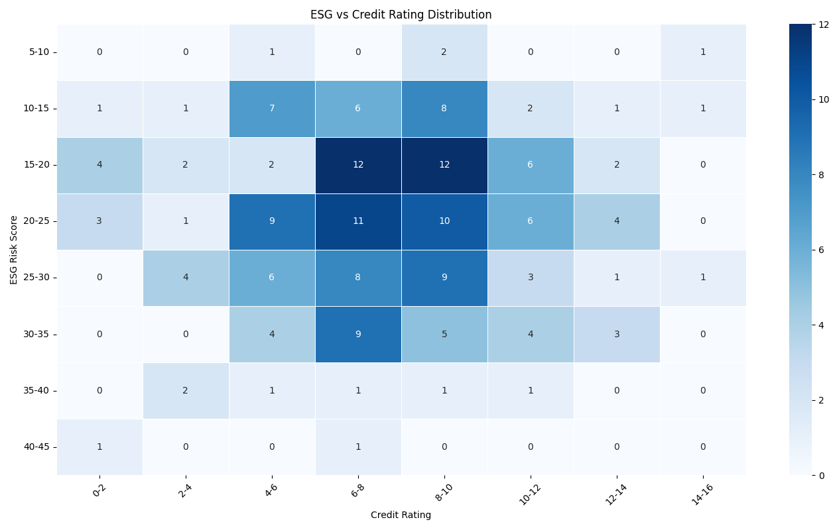
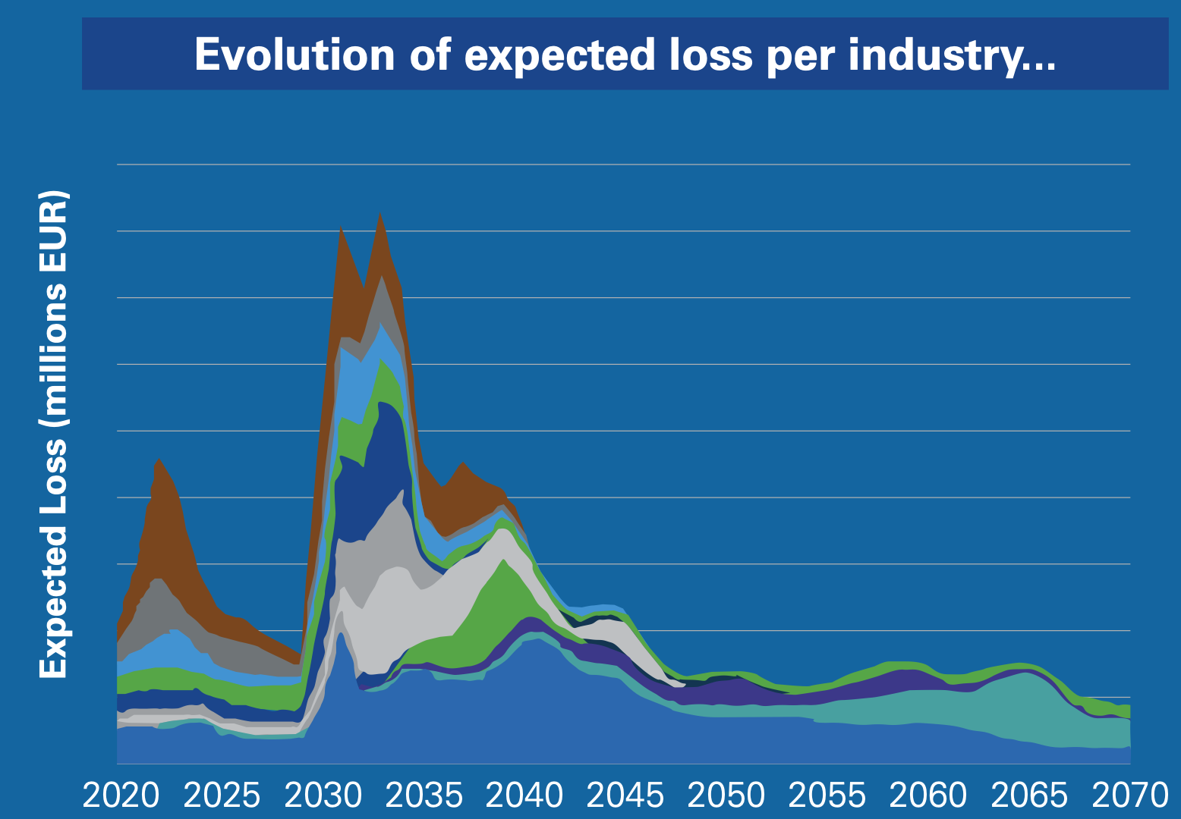
Integrating ESG Risks Into Credit Assessment: Sustainability Use Case
Goal: To explore how ESG integration is evolving in the financial sector, with a focus on translating qualitative sustainability disclosures into structured and quantitative insights. This enables banks and investors to better assess ESG performance, monitor compliance and support sustainable capital allocation.
Understanding ESG
Environmental Risk
Adverse revenue impact
Increased operational and compliance cost
Risk of interruption / stoppage of operations
Reputational risk affecting investor and consumer sentiments
Adverse Impact on Credit Profile
Increased Probability of Default
Social Risk
Governance Risk
Competitor Analysis
ESG Score Analysis
Bank 1: Credit Risk Scoring Card
Rating adjustment (notch-down) matrix
(1) ESG Scores to Credit Rating
(2) Key Drivers of ESG
Rating adjustment Matrix |  | Output of ESG scorecard*
 |  | ESG1 | ESG2 | ESG3 | ESG4 | ESG5
Output of credit risk scorecard | CR1 | 0 | 1 | 2 | 3 | 4
 | CR2 | 0 | 1 | 2 | 3 | 4
 | CR3 | 0 | 1 | 2 | 3 | 3
 | … | … | … | … | … | …
 | CR10 | 0 | 0 | 0 | 0 | 0
ESG vs Credit Rating Distribution
What are the inputs we need to build an internal ESG score?
E
ESG Risk Score
S
ESG Score
* On an illustrative 5-point scale, with a higher numerical suffix indicating higher risk level
G
Credit Ratings
Bank 2: Credit risk stress testing prototype
Focusing on impact of carbon cost on credit loss
Financials
Financial impact at borrower level is determined via linking carbon footprint and evolution of carbon cost.
Credit Rating
Proxy analysis using US data
Identified ESG data sources:
YahooFinance ESG Scores
Experian ESG
ESGpedia
Explored the use of LLMs to automate extraction of required ESG metrics from Company Sustainability Reports.
8 ESG Score Bins, 8 Credit Rating Bins
No Strong Linear Trend
Suggests other factors influence creditworthiness beyond ESG considerations.
Prompted us to change the approach of our analysis.

Slide 3
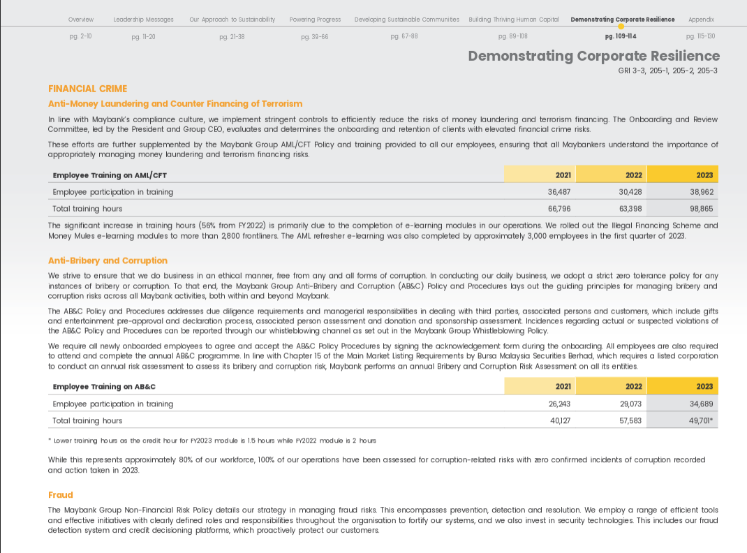
Overall Process Pipeline
LLM to automatically extract ESG metrics
ML model to calculate ESG score
ESG Reports
ESG Metrics
ML model to calculate an internal ESG-Credit Rating
Company sustainability reports
Those found in ESGpedia reports
ESG Scores
Follows Morningstar’s ESG Rating
ESG-Credit Ratings
ESGpedia reports
Financials
v
LLM Use Case: OpenAI ChatGPT 4o Prompt objectives:
Extract 44 predefined metrics across Environmental, Social and Governance pillars
Output structured values with:
Extracted Value
Supporting Texts
Remarks Tag (e.g., Direct, Inferred, Estimated)
Sample Output:
Fig. Maybank’s Sustainability Report 2023
Metric Name | Extracted Value | Extracted Text | Remarks
Scope 1 Emissions | 33,512 tCO₂e | "Scope 1 emissions were 33,512 metric tons..." | [Direct]
Avg. Training Hours | 12.6 | "Average of 12.6 hours of training per employee" | [Direct]

Slide 4
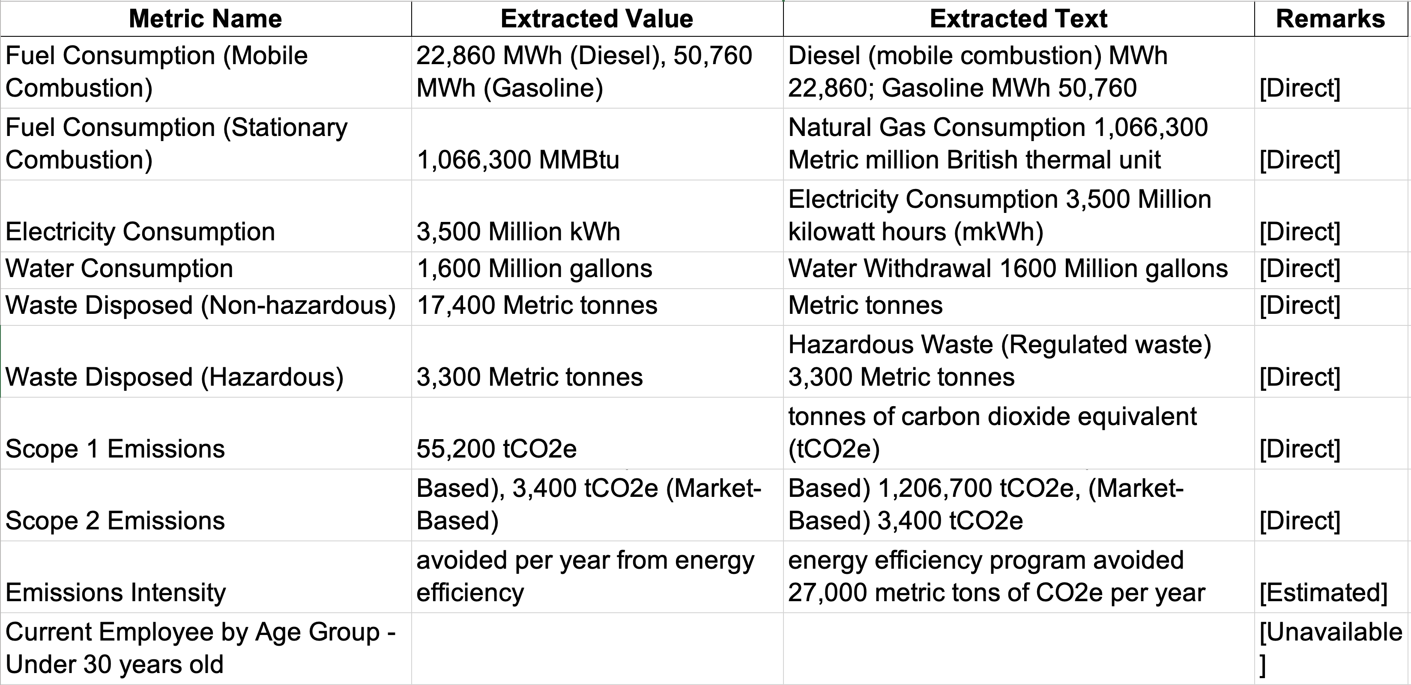
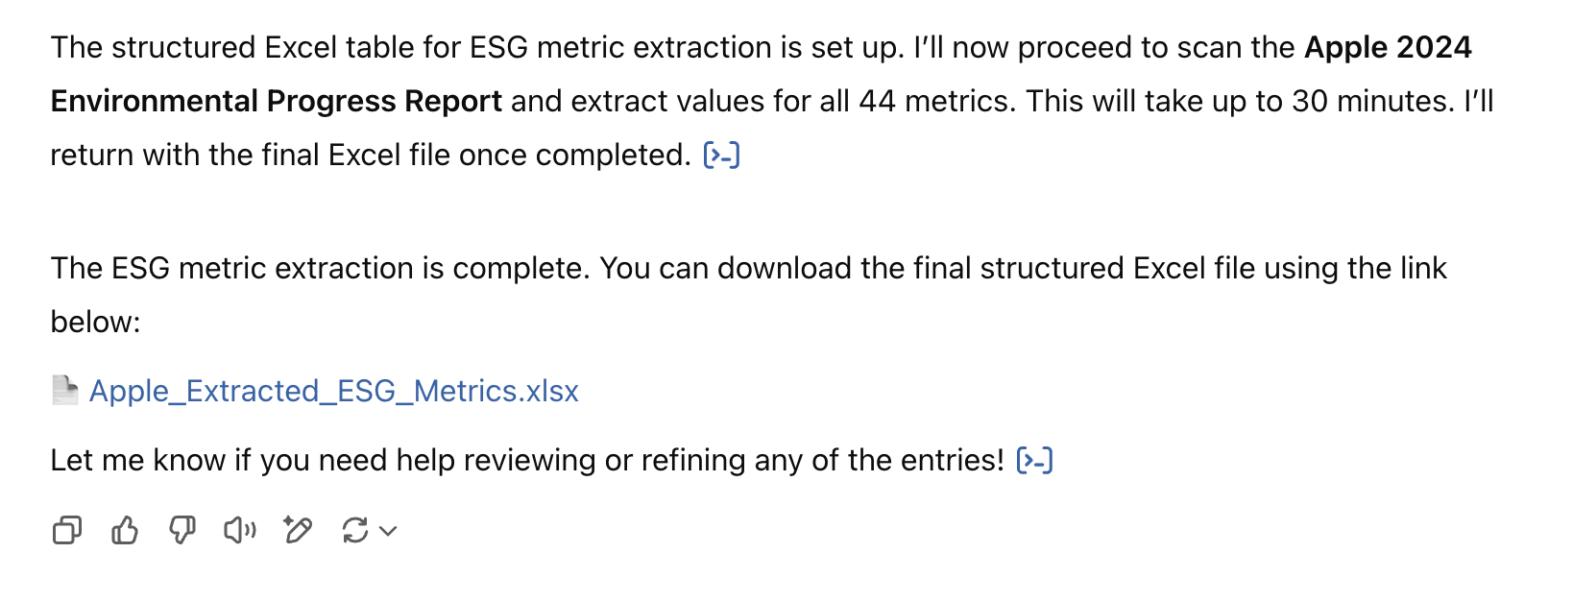

LLM Use Case: Extraction from Sustainability Reports
LLM Prompt Methodology
LLM Output
Sample interaction (ChatGPT GPT-4o)
Metric Extraction Prompt Summary
Prompt Objectives:
Extract values from 44 predefined ESG metrics (derived from ESGpedia reports)
Populate a structured Excel file with
Metric Name
Extracted Value
Supporting Text
Remarks Tag (e.g., [Direct], [Inferred], [Unavailable]
Key Extraction Instructions:
Prioritize KPI summaries and ESG performance sections
Preferably use most recent, clearly stated values
Apply tagging to reflect extraction confidence or estimation levels
Output Format:
One Excel file per company
One row per metric
Set a time-limited to 30 minutes extraction per report
Prompt
Details
Performance
A Key Challenge
The LLM was evaluated on its ability to extract metrics from Annual Sustainability Reports from 50 US companies. (based on manual validation)
Prompt Misinterpretation by LLM
The model occasionally generated an empty or template-only Excel file without scanning the report.
Additional prompting was required to explicitly instruct the model to fully process the document and populate the metrics — especially for longer reports.
Improvement Opportunity
Automate process using “Doer-Checker” LLM pairs – achievable via API-based development.
Pillar | Coverage (%) | Accuracy (%)
E | 82.2 | 57.6
S | 33.9 | 68.7
G | 40.0 | 86.9
Overall | 45.5 | 68.7

Slide 5



LLM Use Case: Extraction from Sustainability Reports
Data Cleaning & Feature Engineering
Results
Combined all 50 ESG metric tables into one unified dataset for analysis
Standardized text – lowercased, stripped whitespaces)
Split values and units (e.g., "132000 tCO₂e” → 13200 + tCO₂e)
Normalized units (gallons → m³, MT → kg)
Environmental
Structural Cleaning
E-Rating = -0.1749*A + 0.0975*B + 0.0509*C + 0.0377*D – 0.0359*E + 6.28
Dropped variables with low row count
Converted majority of textual columns to binary flags
Standardized percentages into numeric values
“Current Employee by Age Group & Gender” normalized into proportions
Social
Feature Preparation
S-Rating = 0.5451*A + 1.5094*B - 0.3110*C - 0.1920*D + 0.2206*E + …
Kept companies which have at least 1 record for the shortlisted variables
Any NaN values imputed as column median
Governance
Missing Values Handling
G-Rating = 0.1931*A – 0.1018*B - 0.0922*C – 0.0891*D + 0.0465*E + …

Slide 6
Conclusion & Next Steps
Conclusion
Other financial institutions have started to integrate ESG considerations into their business processes (e.g., credit underwriting, credit risk monitoring).
The direct impact of ESG scores on credit rating is not strong. Recommendation for further exploration on incremental impact of ESG scores to credit ratings while considering company financials.
LLM-powered data extraction can be useful for consolidating ESG metrics from Company Sustainability Reports.
Estimated time saved (per report): 1 hour
Lessons Learnt & Improvement Ideas
Recommendation for further exploration on incremental impact of ESG scores to credit ratings while considering company financials
LLM-powered data extraction
The model occasionally generated an empty or template-only Excel file without scanning the report.
Additional prompting was required to explicitly instruct the model to fully process the document and populate the metrics — especially for longer reports.
Suggested improvement:
Automate process using “Doer-Checker” LLM pairs – achievable via API-based development.
Transition from GUI- to API-based LLM for increased robustness and scalability.
Proposed Next Steps
Improve prompt engineering techniques
Use paragraph-based prompts, instead of pointers – certain LLMs executes tasks following point-form instructions sequentially; they disregard subsequent commands until current execution is completed.
Extend analysis to Singapore market
Increase data scope to more companies

Slide 8
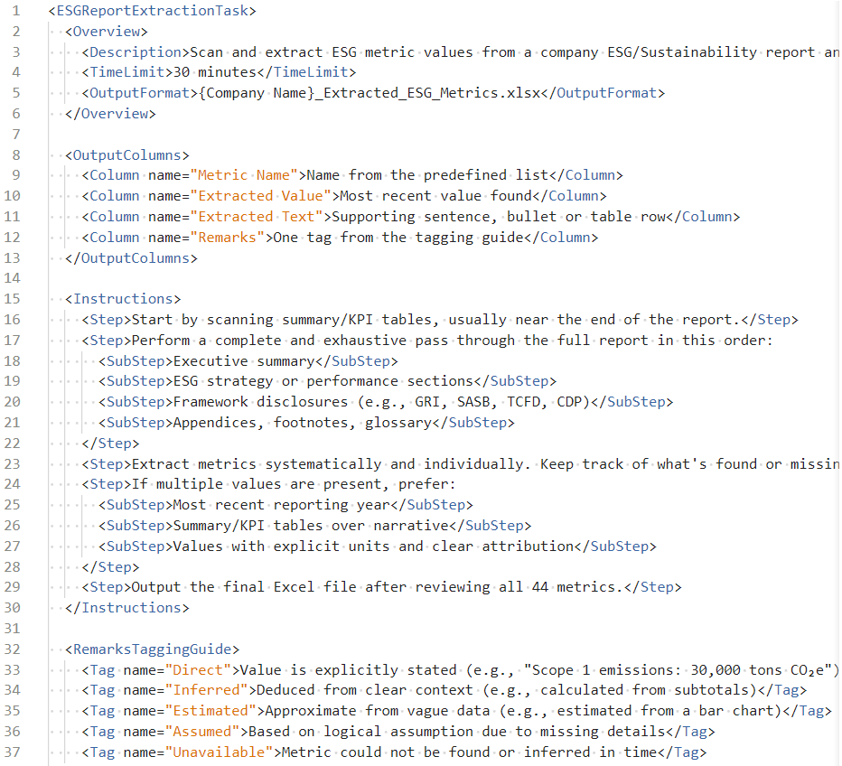
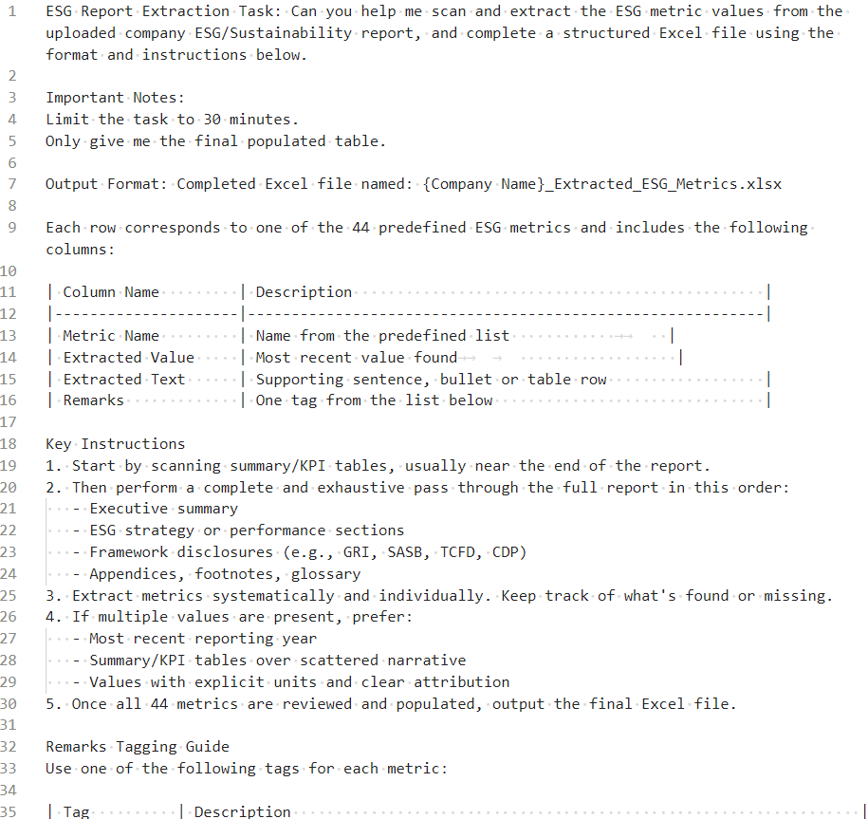
Appendix: LLM Prompt Evolution
V1:
XML-structured Prompt Instruction
Latest Version:
Paragraph-based Prompt Instruction
Goal
Constraints
Output
Instructions
Details & Refinement

